Slide 1


Avalanche Safety Basics
Steven McDonald
International Mountain Leader
BASI ISTD Snowboard Instructor

Slide 2
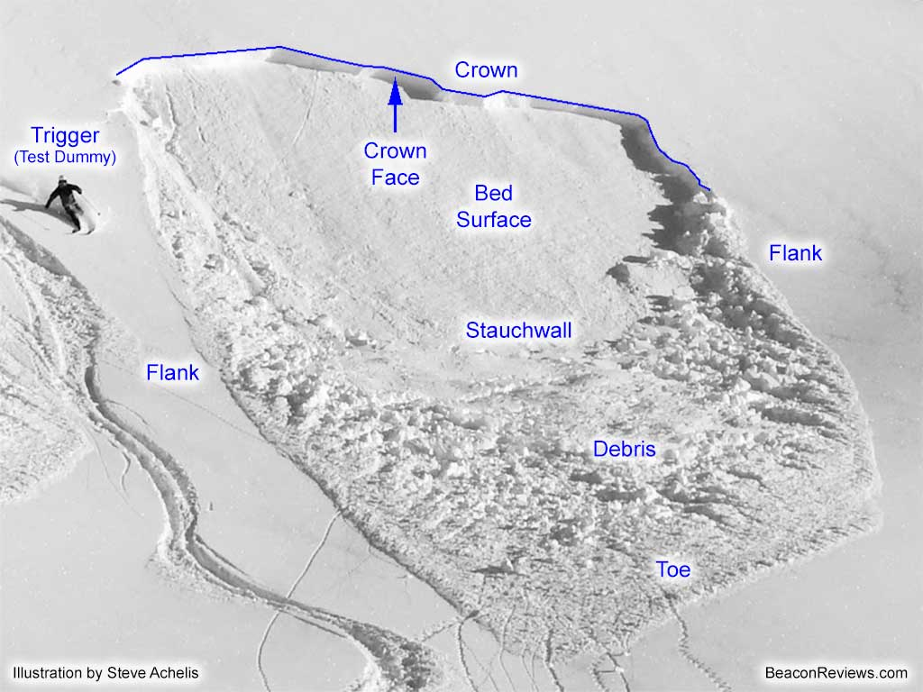
What is an avalanche?
A mass of snow sliding down a slope

Slide 3
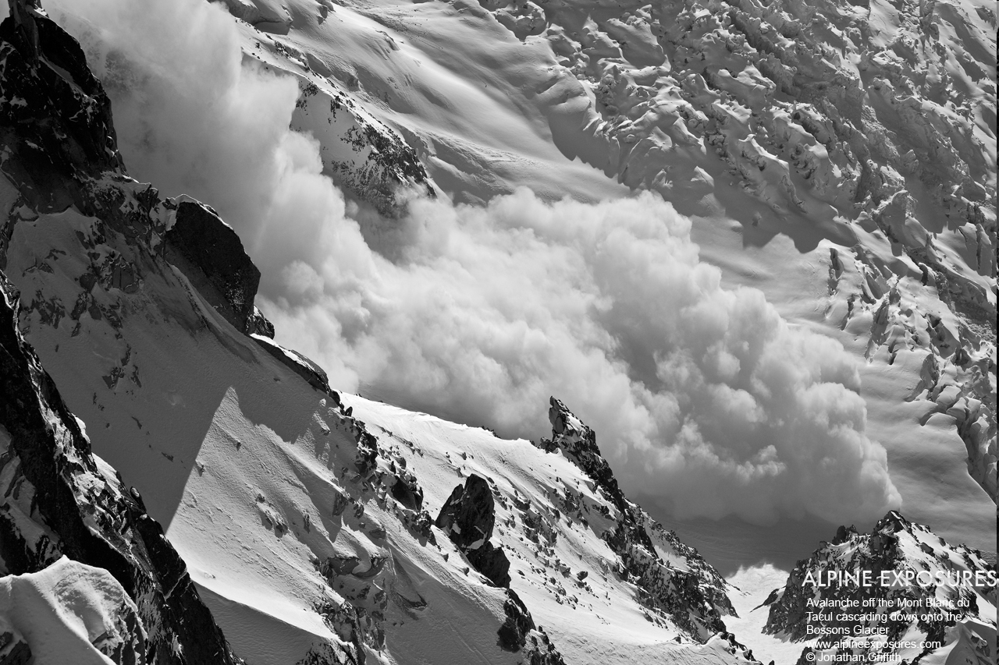
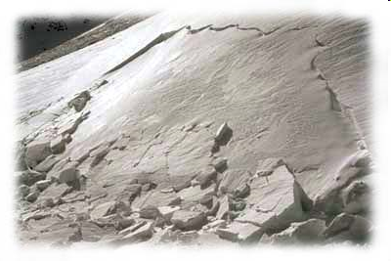
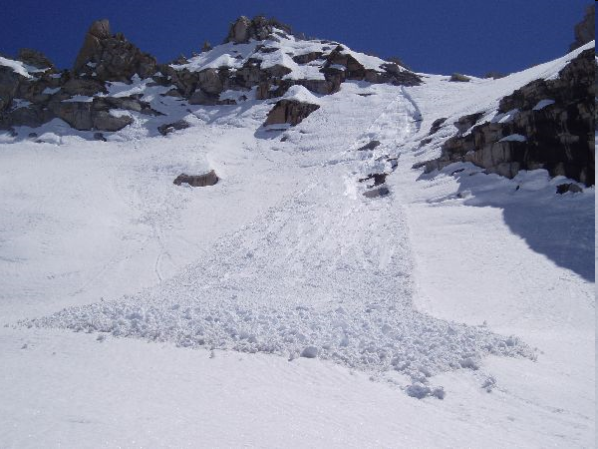
Types of Avalanche
There are 3 main types of avalanche:
Powder Slab Wet Snow
Slabs are by far the most dangerous for winter travellers in the mountains. They are relatively small, but easily human-triggered.

Slide 4
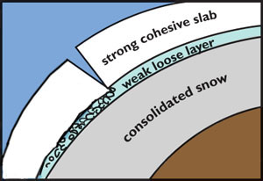
What is a slab avalanche?
A slab is when a weak layer buried in the snowpack allows the top part of the snowpack (the slab) to slide on the layer underneath (the bed surface)
Weak layers:
  Windslab
  Depth hoar
  Buried surface hoar
Bed surfaces:
  Firm, old snow
  Rain or wind crusts
  The ground (rock slabs, grass…)

Slide 5
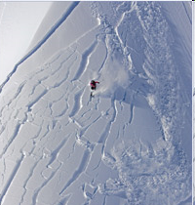
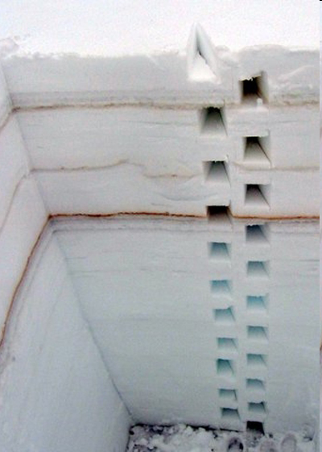
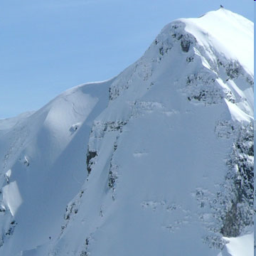
What makes an avalanche accident?
The danger triangle:
People
Terrain
Snowpack

Slide 6
Avalanche Terrain
Any slope steeper than 20-25° (most dangerous 38°)
  Blue run = 15°, Red = 20°, Black = 25° (average)
  Steepest groomed terrain = 30-35°
  Morion = 33°
  North Face Fogliettaz entrance = 38° !
  “Extreme skiing” = 45°+
38°

Slide 7
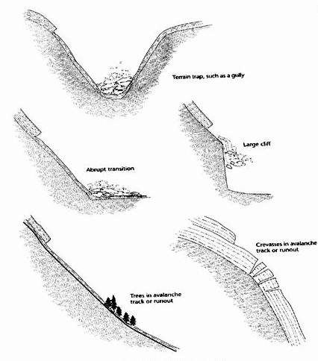
Terrain Traps
Anything which increases the consquences of getting dragged down in an avalanche:
Gullies, bowls and man-made barriers (deep burial)
Cliffs, rocks, trees, crevasses (impact injury)

Slide 8
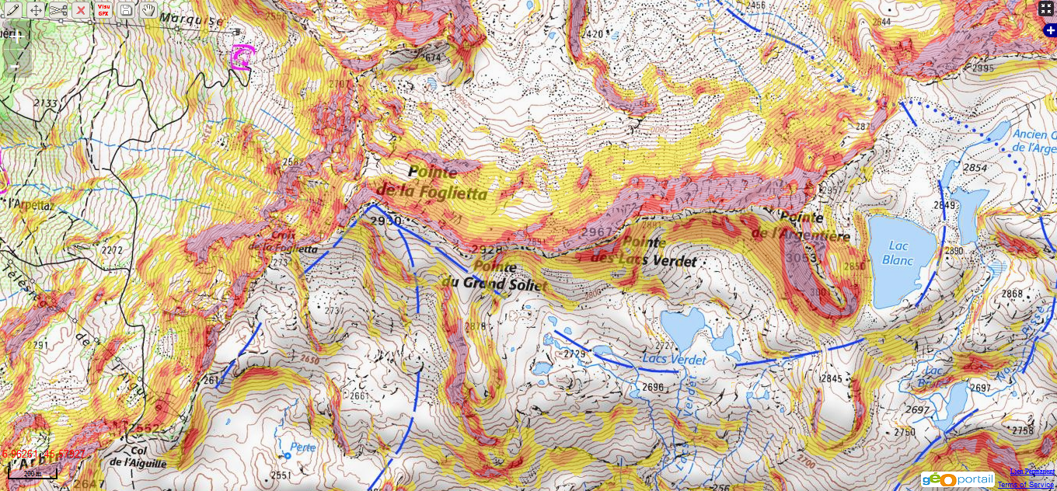
Choosing Terrain
30°
35°
40°
45°
Sainte Foy: http://www.skitrack.fr/?zoom=15&lat=45.57903&lon=6.94781&layers=IGN%20Carte%7CPentes%20IGN%7C
Tignes: http://www.skitrack.fr/?zoom=15&lat=45.57903&lon=6.94781&layers=IGN%20Carte%7CPentes%20IGN%7C

Slide 9
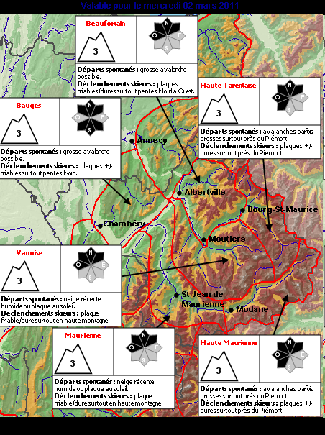
Snowpack
Most difficult thing to evaluate
Get external information
Seasonal observation and avalanche reports better than pits

Slide 10
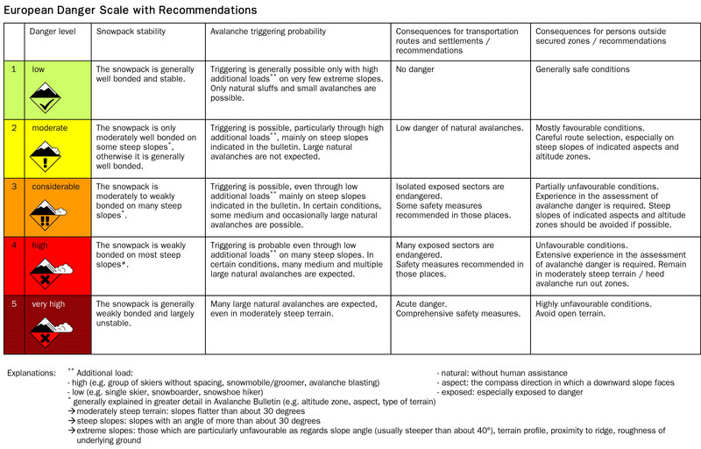
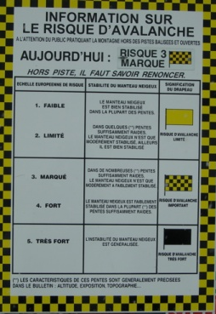
Snowpack

Slide 11
Snowpack
Look up, not down! Danger signs
  Recent avalanche activity
  Creep & glide cracks
  Wind (blowing snow, rime, sastrugi)
  Sluffs/slides around tracks
  Ski-patrol bombing
  Tracks, skiers & snowboarders
  Sun-balls

Slide 12
Snowpack
Avalanche risk increases with:
  Rapid snow loading (snowfall, wind)
  Rapid temperature changes
  Cold temperatures on thin snowpack (depth hoar formation)
  Rain

Slide 13
Snowpack
Weak Layers:
  Depth hoar
  Surface hoar (frost)
  New snow
  Graupel
  Wet snow
Weak Interfaces:
  Windslab
  Sun crust
  Rain crust
  Melt/freeze crust

Slide 14
Snowpack
Depth hoar (facets, sugar-snow, “goblets”)
Cold air (-30°C)
Deep snowpack
Gentle temperature gradient
Shallow snowpack
Steep temperature gradient
Warm ground (0°C)

Slide 15
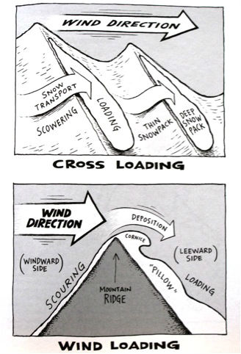
Snowpack – Wind Slab
Classic “snowflakes” are broken up by wind swirling over terrain features. The broken pieces are packed together densely and form a firm, cohesive layer.
The windslab layer can be fragile and can shatter like meringue or polystyrene

Slide 16
People
Safe travel
Risk-reduction factors
Heuristic Traps
Self-rescue
Statistics

Slide 17
Safe Travel
Enter avalanche terrain cautiously
Move one at a time
Use islands of safety
Do not ride above your own group or anyone else
Climb on ridges, do not pass below avalanche paths & run-outs

Slide 18
Risk Reduction Factors
90% of all avalanches happen within 24hrs of fresh snow-fall
If risk is high, stay out of avalanche terrain
Practise safe travel
Assess run-outs & consequences
Plan escape routes
Start small
Communicate
Equipment
Munter method / 3x3 method

Slide 19
3x3 (Munter) Risk-reduction
Risk = 2 to the power of warning level (i.e. level 3 = risk 8)
Reduction Factors:
First Class, Slope Angle
Steepest Slope Angle is between 35°-39° : 2
Steepest Slope Angle is between 30°-34° : 4
Second Class, Slope Aspect
Route avoids North sector slopes (NW-N-NE) : 2
Route avoids North half sector slopes (WNW-N-ENE) : 3
Route avoids Named Avalanche Slope Sectors : 4
Third Class, Group Factors
Slope stabilized by skiing: 2
Large group with good spacing: 2
Small Group (2 to 4 skiers) : 2
Small Group with good spacing: 3
Final risk = Risk / (Factor 1 x Factor 2 x Factor 3)
If remaining risk > 1, don’t go!

Slide 20
Heuristic Traps
Limited opportunity
  “It’ll be tracked by tomorrow”, “We have to go home tomorrow”
Summit fever
  “I’ve wanted to do this run for ages”
Everybody else is doing it
  “There are loads of tracks”
Familiarity
  “I’ve been here loads of times and never had any trouble”
Risk compensation
  “It might be a bit sketchy – have you got a transceiver on?”
Ability level
  “It’s OK, I’m a really good snowboarder”

Slide 21
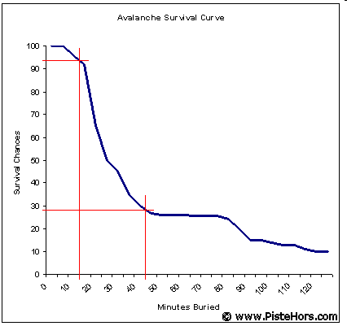
Self-rescue
If you are buried in an avalanche, you have 15 minutes to be rescued before your chances of survival drop dramatically
Your ONLY chance is to be rescued by your mates. Organised rescue will be too late.

Slide 22
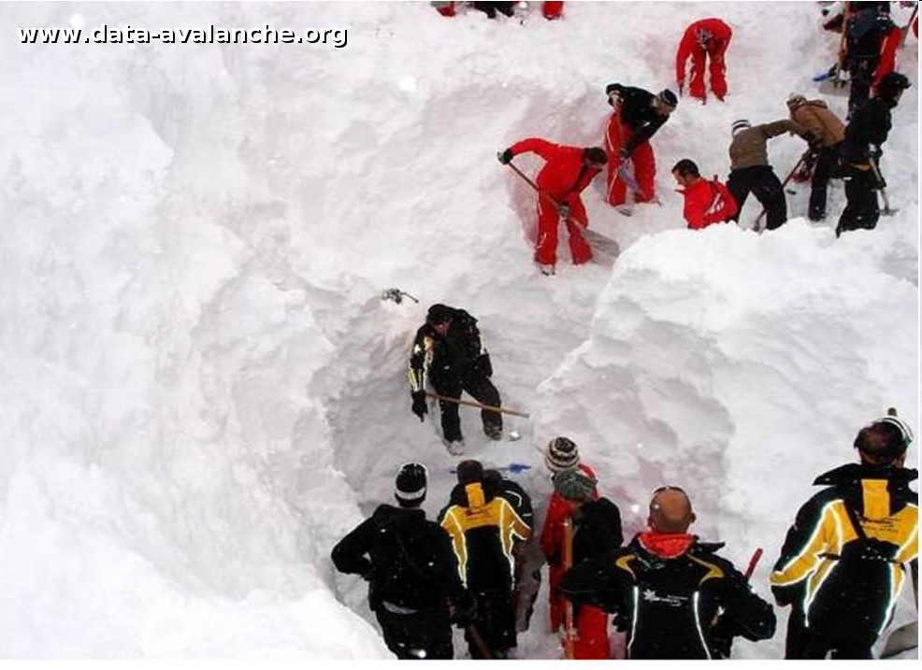
Equipment
Transceiver, shovel, probe
ABS
Avalung
If you need any of it, you’ve already ****’ed up!
If you are completely buried, your chances of survival are 50/50, regardless of equipment
Les Arcs avalanche, 1st January 2010

Slide 23
What to do if the worst should happen
To you:
  Try to ride out gently to the side
  Try “swimming” or rolling
  As the slide comes to a stop, try to use one head to cover your mouth & nose (to create an air pocket) and punch up as high as you can with the other
  Once it stops, there is pretty much nothing you can do except try keep calm and hope
To your friend:
  Watch them closely, don’t look away
  Mark their “last-seen” point
  Is it safe?
  Stop, think, plan
  Don’t send someone for help, phone if you can spare the time & resources
  Start a transceiver search quickly
  Look for clues on the surface as you search

Slide 24
Transceiver Search
Phase 1
  Cover all the terrain as efficiently as possible until you find a signal. Move quickly.
Phase 2
  Follow the flux-line. Change transceiver orientation to keep the strongest signal. Move quickly
Phase 3
Keep the transceiver in the same orientation. Make a methodical grid-search, but don’t waste time – start probing!
Probing
  Probe perpendicular to slope, not vertically
  Probe in a spiral, spacing about 20cm
  Leave probe in when you get a strike
Digging
  Start digging downhill from the probe-strike, about 1.5x the probe depth
  Dig in, not down
40m

Slide 25
Further Reading
Staying Alive in Avalanche Terrain
  Bruce Temper
Freeriding in Avalanche Terrain – A Snowboarder’s Handbook
  Bruce Jamieson & Jennie McDonald
Snow Sense
  Jill Fredston & Doug Fesler
The ABC of Avalanche Safety
  E R LaChapelle
A Chance in a Million – Scottish Avalanches
  Blyth Wright
On-line:
  www.avalanches.org (Links to all European forecasting sites)
  www.anena.net (French National Snow/Avalanche Study site)

Slide 26
3 things to take away
Read the avalanche report
Move one at a time
Be patient

Slide 27
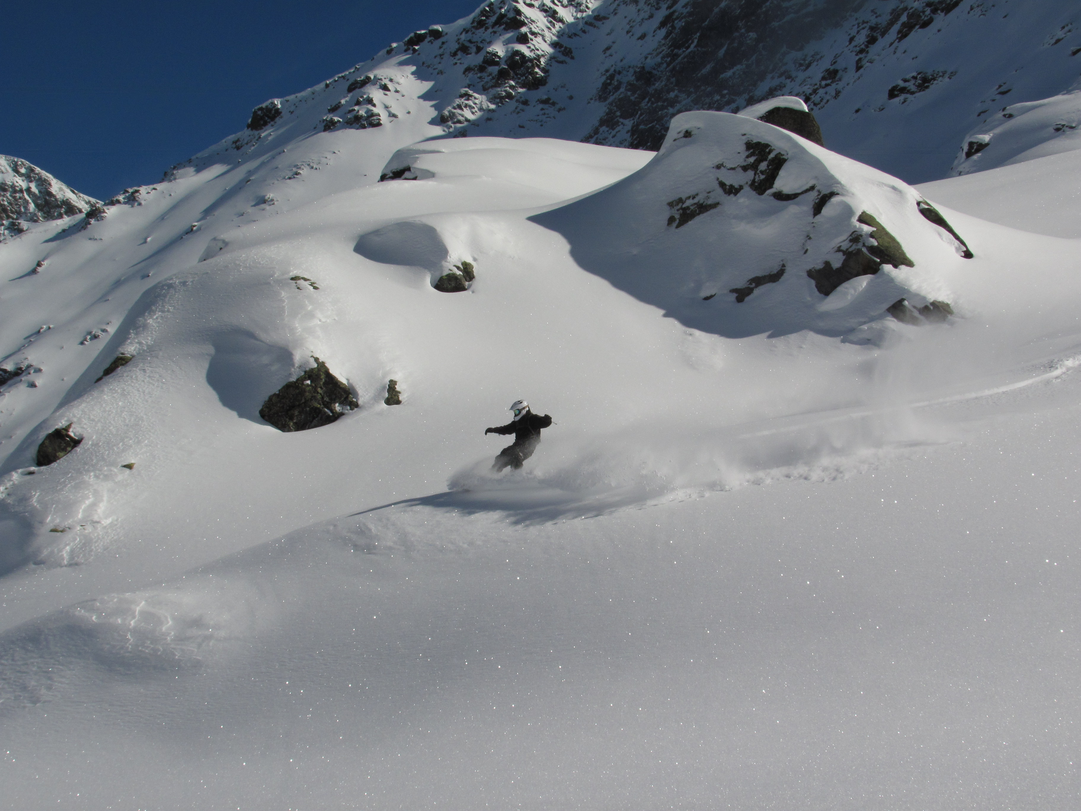
Have fun, be safe!

Slide 28
Gear Recommendations
Transceiver
  Ortovox 3+
  Barryvox
Shovel
  Anything with a metal blade
Probe
  Around 240cm

